Slide 1

s
Presentation
On
EMAIL AUTOMATION USING LLMS
Group Number: 26
Presented by
VIVEK KUMAR
VATSAL CHAUDHARY
VISHVESHVER
SHREYANSH SINGH RATHORE
Under the Supervision
DR. ASIF KHAN
(Department of CSE _GNIOT Greater Noida, India)

Slide 2
Table of Contents
1.Introduction
2.Research Objectives
3.Literature Survey
4.Proposed Model
5.Discussion About Methodology & Algorithm
6.Conclusion & Future Work
7. Research Paper Progress
8.References

Slide 3
1.Introduction
Email communication remains essential, but long threads and frequent follow-ups make manual drafting slow and inconsistent in professional workflows.
Our problem statement is to reduce response time while preserving context, tone, and action clarity across high-volume email conversations.
The proposed approach uses an algorithmic pipeline: context extraction, intent understanding, priority estimation, prompt construction, adaptive model selection, and response refinement.
This enables four core outcomes: concise thread summaries, response drafts, tone-aware rewriting, and category plus priority decisions for faster human review.

Slide 4
2.Research Objectives
Design a robust end-to-end methodology for transforming raw email threads into structured AI-ready context with subject, sender intent, and key constraints.
Develop an adaptive response algorithm that selects the most suitable generation strategy by task type (summarize, reply, rewrite, classify) and required quality level.
Create a priority and action-item extraction stage so each output highlights urgency, decision points, and next actions rather than only generating free-form text.
Evaluate effectiveness using measurable criteria: response relevance, tone consistency, summary compression quality, and reduction in average drafting time.
Establish a monitoring methodology that tracks latency, token usage, and output quality feedback to continuously improve prompts and routing decisions.

Slide 5
3.Literature Survey
Transformer research established long-context understanding, making it feasible to summarize multi-message threads and preserve conversational dependencies.
Recent prompting studies show that structured instructions and explicit output formats significantly improve reliability for professional writing tasks.
Earlier email automation systems were template-driven, where outputs were fast but generic and weak at handling nuanced intent or changing context.
Current LLM-powered tools improve fluency, but many studies report variability in tone control and decision consistency without task-specific routing logic.
The key gap is an integrated methodology that combines context extraction, adaptive generation, and decision-oriented post-processing in one workflow.

Slide 6
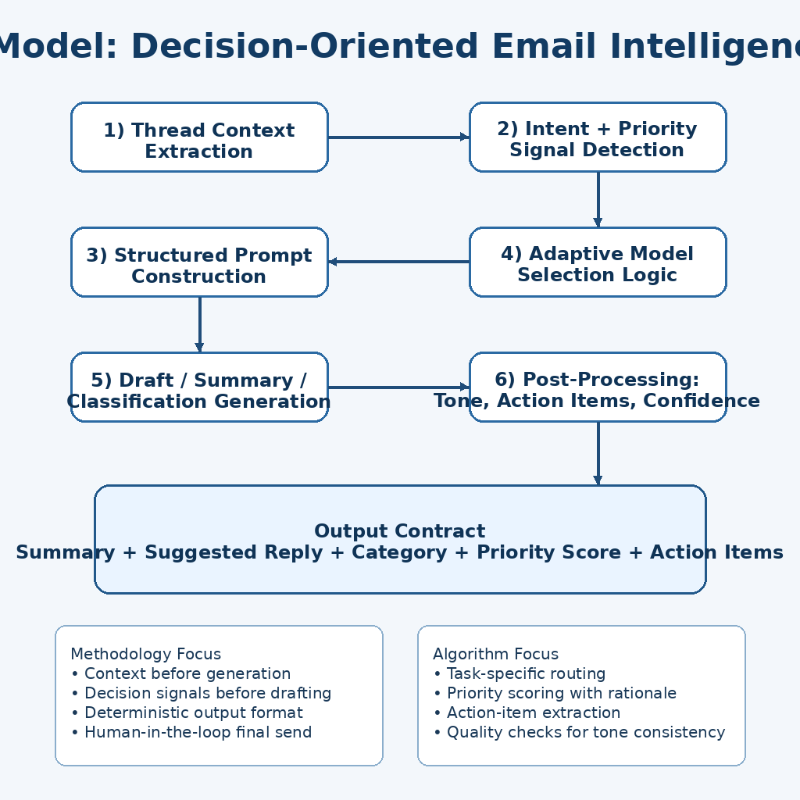
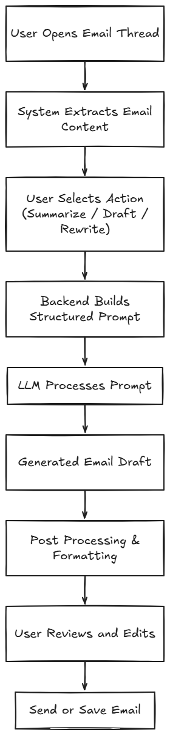
4.Proposed Model

Slide 7
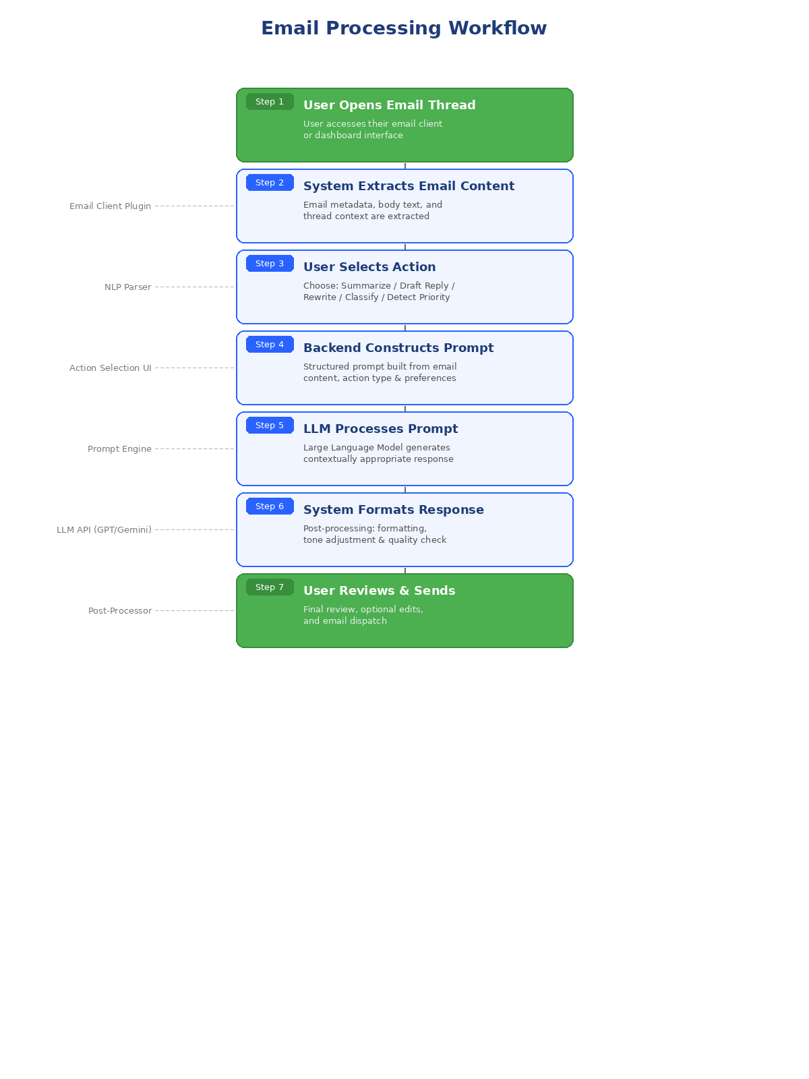
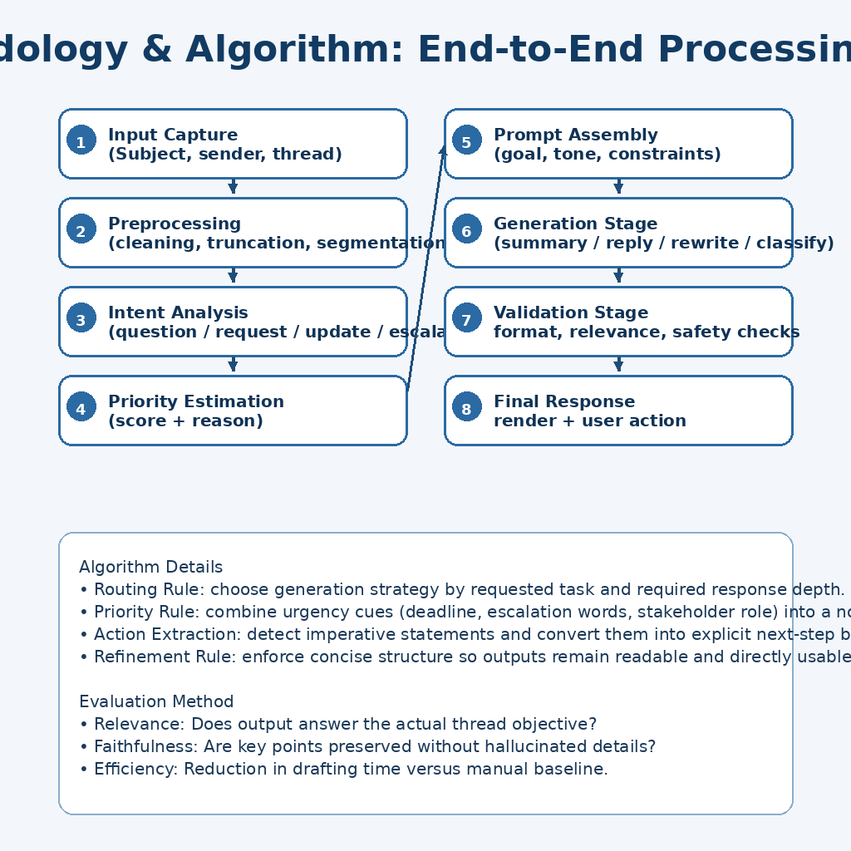
5.Discussion About Methodology & Algorithm

Slide 8
6.Conclusion & Future Work
Conclusion:
LLM-based email automation systems can significantly reduce the manual effort and time invested in professional email drafting and communication.
The proposed architecture demonstrates effective integration of prompt construction, LLM processing, and post-processing layers to generate contextually appropriate and personalized email content.
Future Work:
Multilingual email generation to support global enterprise communication.
Improved personalization through advanced user preference learning and behavioral analysis.
Enterprise system integration with CRM, ERP, and collaboration platforms.
Context-aware AI assistants capable of proactive email management and intelligent scheduling.

Slide 9
7. Research Paper Progress
Architecture Design: The system architecture comprising the user interface layer, backend processing layer, LLM processing layer, post-processing layer, and data intelligence layer has been finalized.
Literature Review Completion: A comprehensive review of transformer-based models, prompt engineering techniques, and prior email automation systems has been completed and documented.
Prototype System Development: An initial prototype demonstrating core email generation, summarization, and tone rewriting capabilities has been developed and tested.
Experimental Evaluation: Benchmarking and evaluation metrics for measuring productivity improvements, response quality, and user satisfaction are being defined for systematic assessment.

Slide 10
8.References
[1] Vaswani, A. et al., "Attention Is All You Need," Advances in Neural Information Processing Systems (NeurIPS), 2017.
[2] Schulhoff, S. et al., "The Prompt Report: A Systematic Survey of Prompting Techniques," arXiv preprint, 2024.
[3] Google, "Gemini API Reference," Google AI for Developers, 2024. [Online]. Available: https://ai.google.dev/docs
[4] Al-Debagy, O. and Martinek, P., "A Comparative Review of Microservices and Monolithic Architectures," Budapest University of Technology and Economics, 2018.
[5] Dilip, K., "Review on SMTP Protocol for E-Mail Systems," Galgotias University, Department of Computer Science and Engineering, 2020.
[6] Chen, M. et al., "Leveraging Generative AI in Enterprise Applications," IEEE Conference on AI and Business Operations, 2023.

